Slide 1
Church – Turing John Roger Searle Stuart Madnick
All Computers are Equivalent

Slide 2

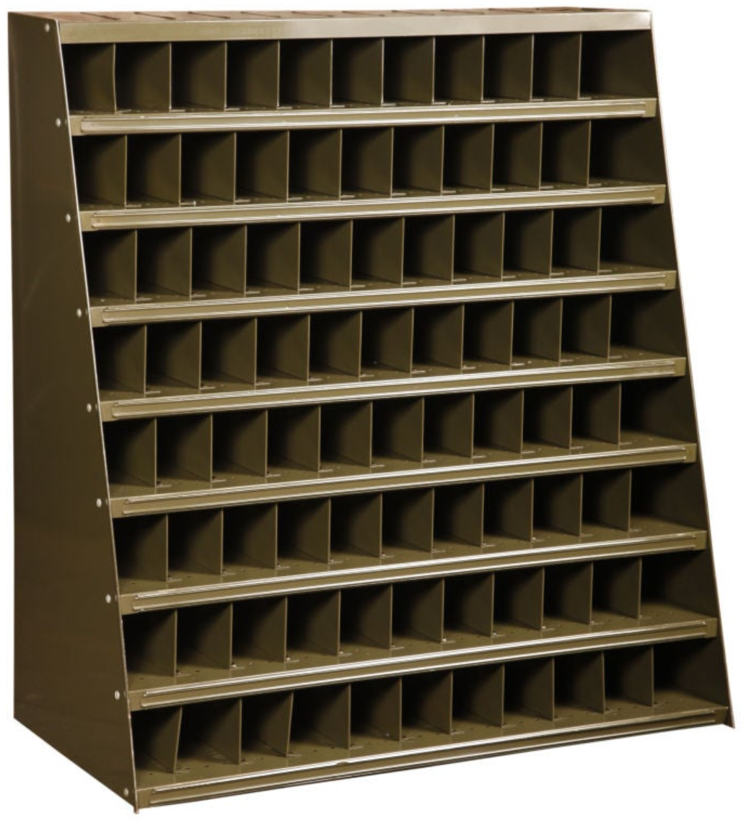





Little Man Computer
Notes:
This is our model of a computer.
Inside the computer is a ‘little man’ who, for want of another name, we will call Bruce. Bruce is the ‘brains’ of the computer and works in a hermitically sealed room inside the computer.
The only way Bruce can communicate with the outside world is by posting written notes into the ‘out’ Postbox. The only way we (the computer users) can communicate with Bruce is by posting notes through his ‘in’ letterbox.
When Bruce receives a note from us (through his ‘in’ letterbox) he:
Reads our note
Checks in his manuals how to ‘do’ anything he is uncertain about
Uses his pens and paper to work out the result we have asked him for
Writes the result on a fresh piece of paper and posts it to us in the ‘out’ Postbox
Although Bruce is great at simple arithmetic and comparing things (he never tires of it), anything more complicated he must look up in his manuals.
Bruce is willing to do any amount of complicated calculating for us but if the ‘how to do it’ instructions are not in his manuals then we must give him detailed instructions as to how to do it with every step simple enough for Bruce to understand.
Bruce’s strengths are speed and accuracy. He is however very limited in other ways. At most he can remember only half a dozen numbers or letters at any one time. Anything more than that he must put in his filing system which he calls his ‘Memory’. He puts it in a memory bin and makes a note of the bin number in his notebook. This means that when he needs that information later, he just looks up its location in his notebook and then retrieves it from that memory bin.
Memory bins are very capacious. We could put all of Tolstoy’s ‘War & Peace’ in one bin.
Memory bins can contain anything. Numbers, individual letters, homeworks, books, photos, films, etc,. They can even contain the instructions for doing a particular task.
At the end of every day Bruce clears all the used paper and notes from his desk, empties every bin in memory – and puts the whole lot in recycling so that he can make a completely clean start next day.

Slide 3
Addressable
Memory
Manuals
OUT
IN
pens
jotters

Slide 4
Python – Variables
A variable is:
the name of an address in memory
that contains a value

Slide 5
Bruce’s notebook
Memory
Address
 | 0 | 1 | 2 | 3 | 4
0
1
2 |  | 0
3
4 |  |  | 6
Variable
Name | Address
apples | 21
values
Variable
Name | Address
oranges | 42

Slide 6
Python – Functions
A function is:
the name of an address in memory
that contains some executable code

Slide 7
Bruce’s notebook
Memory
Address
 | 0 | 1 | 2 | 3 | 4
0
1 |  | max
2
3
4 |  |  |  |  | signum
Function
Name | Address
max | 11
values
Function
Name | Address
signum | 44

Slide 8
Python – Objects
A object is:
the name of an address in memory
that contains some executable code & data

Slide 9
Bruce’s notebook
Memory
Address
 | 0 | 1 | 2 | 3 | 4
0 |  |  |  | ‘Pat’
1 | ‘Axl’
2
3
4
Object
Name | Address
fname | 13
values
Object
Name | Address
sname | 10

Slide 10
Variables, Functions, Objects, Classes, Modules & Packages
A variable/function/object/class is:
the name of an address in memory
that contains data and/or executable code
A module is:
the name of a file.py in file-system memory
that contains executable code
A package is:
the name of a module
that contains sub-modules and/or sub-packages

Slide 11
Bruce’s notebook
Memory
Address
 | 0 | 1 | 2 | 3 | 4
0 |  |  |  | ‘Pat’
1 | ‘Axl’ | max
2 |  | 0
3
4 |  |  | 6 |  | signum
Variable
Name | Address
apples | 21
Variable
Name | Address
oranges | 42
Function
Name | Address
max | 11
Function
Name | Address
signum | 44
Object
Name | Address
sname | 10
Object
Name | Address
fname | 13

Slide 12
End Here

Slide 13
Scenario: You have written a module of functions (ojf.py) that accurately predicts the orange juice futures market You are now trying to crack the tomato juice futures market and want to reuse many of the orange juice functions. How to do this without copying the code?

Slide 14
Answer: The import statement
import ojf
# imports everything in the ijf module
define tomato_futures(t_data):
return ojf.orange_futures(t_data)
from ojf import orange_futures
# imports only the named function or object
define tomato_futures(t_data):
return orange_futures(t_data)

Slide 15
Worksheet
Try the examples and questions yourself

Slide 16
Bruce’s notebook
Address
Memory
 | 0 | 1 | 2 | 3 | 4 | 5 | 6 | 7 | 8 | 9
0
1
2
3
4
5 |  |  |  | 0
6
7 |  |  |  |  |  |  |  | 6
8
9
Variable
Name | Address
apples | 53
a value
a value
Variable
Name | Address
oranges | 77

Slide 17
Can you solve this problem?
A = ‘any piece of text’
Divide it into two pieces (don’t care where the division is)
B = first part
C = Second part
So that B+C equals A
a = ‘any piece of text’
# that 17 characters long
# set dividing line at char 7
# ‘any pie || ce of text’
b = a[0:8]
c =a[8:]
b + c # should be a

Slide 18
Computers
A short diversion into the internal architecture of computers

Slide 19
Computers & Python & Programming
Computer
Python
Everything (almost) is an object
Translation
It’s BINARY all the way down
…
…
…
…
Machine instructions
CPU
object
object
object

Slide 20
Binary & Unicode
Integer
Symbol
Character
Emoji

